Slide 1

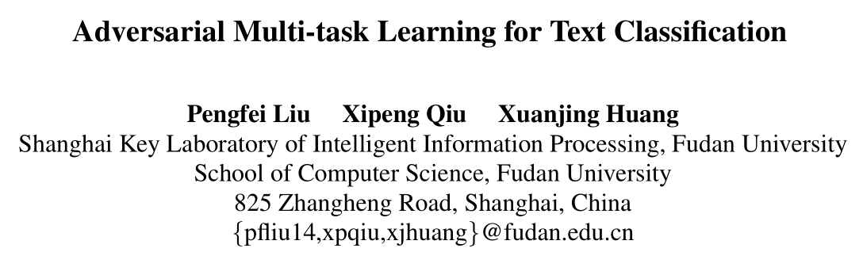

Slide 2
Neural network models have shown their promising opportunities for multi-task learning, which focus on learning the shared layers to extract the common and task-invariant features. However, in most existing approaches, the extracted shared features are prone to be contaminated by task-specific features or the noise brought by other tasks.

Slide 3

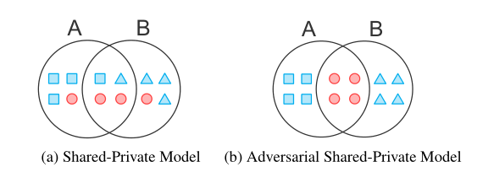

Slide 4
The infantile cart is simple and easy to use. (neutral)
This kind of humour is infantile and boring. (negative)
However, the general shared-private model could
place the task-specific word “infantile” in a shared space, leaving potential hazards for other tasks.
Additionally, the capacity of shared space could also be wasted by some unnecessary features.

Slide 5
Contribution
Proposed model divides the task-specific and shared space in a more precise way, rather than roughly sharing parameters.
We extend the original binary adversarial training to multi-class, which not only enables multiple tasks to be jointly trained, but allows us to utilize unlabeled data.
We can condense the shared knowledge among multiple tasks into an off-the-shelf neural layer, which can be easily transferred to new tasks.

Slide 6
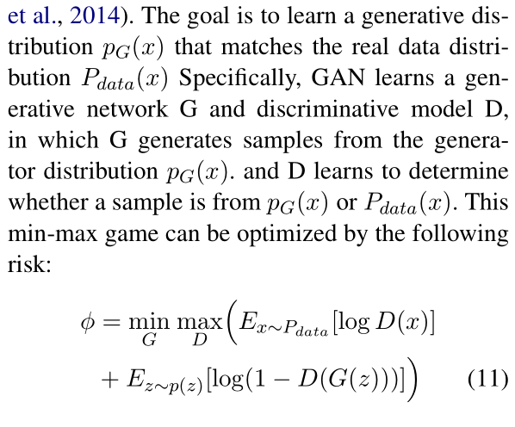
Adversarial network
1

Slide 7
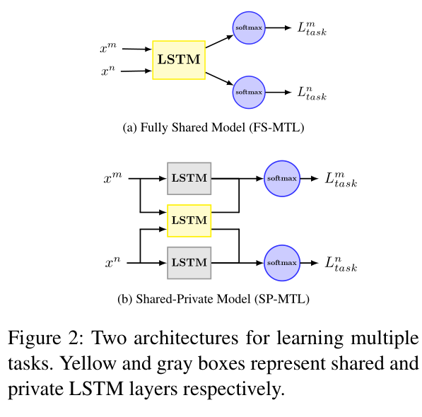

Slide 8
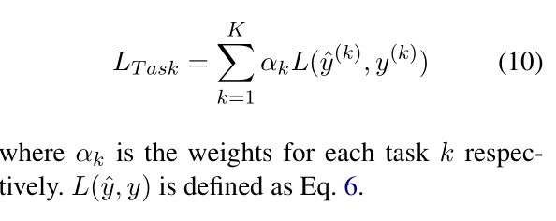
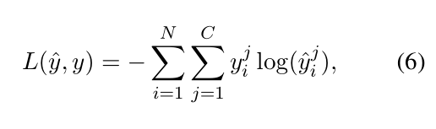
Task-specific output layer

Slide 9
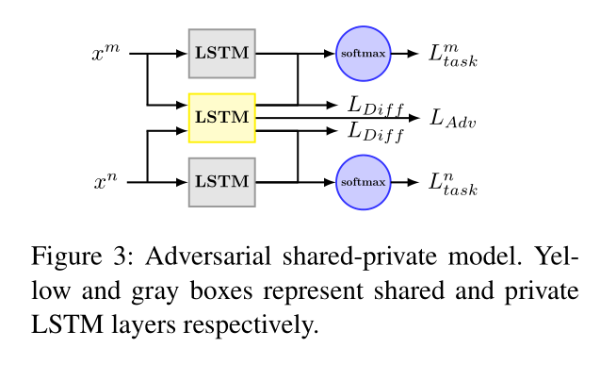
Incorporating Adversarial Training
A good shared feature space should contain more common information and no task-specific information

Slide 10
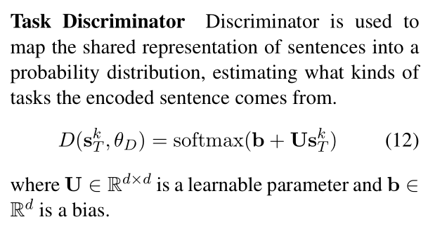

Slide 11
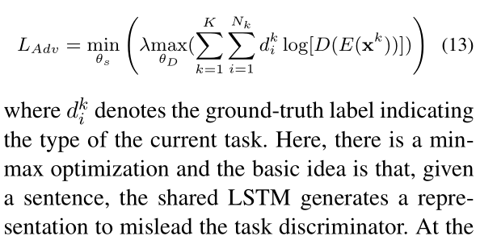

Slide 12
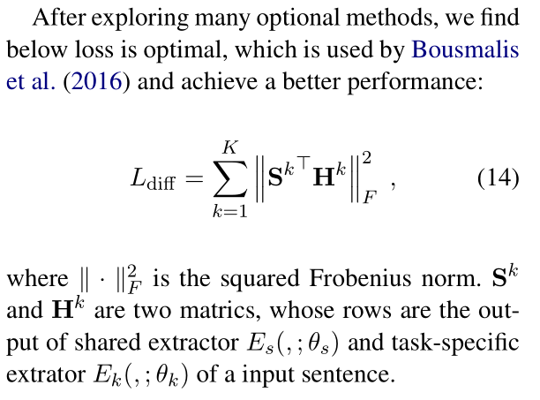
Orthogonality Constraints

Slide 13
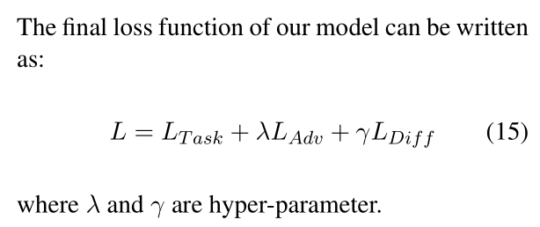
λ as 0.05 and γ as 0.01
1

Slide 14
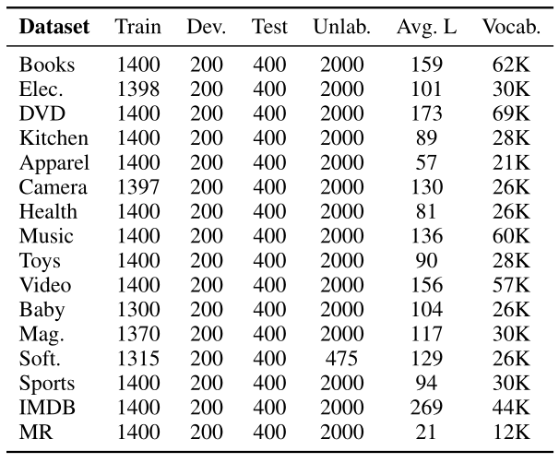
Experiments

Slide 15
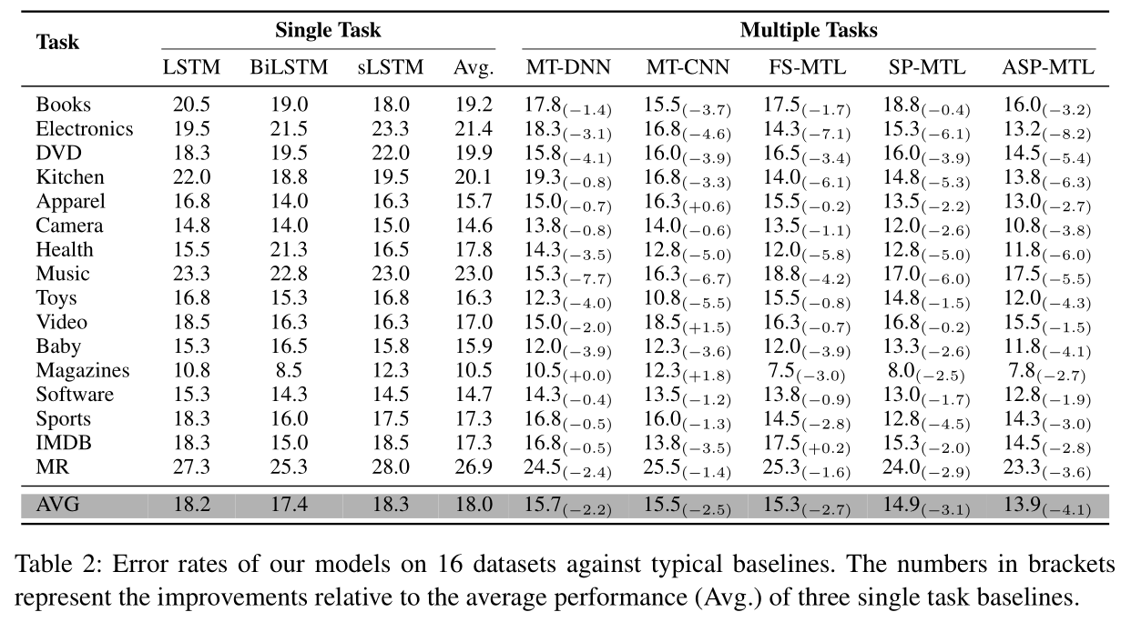

Slide 16
Knowledge transfer
To test the transferability of our learned shared extractor, we also design an experiment, in which we take turns choosing 15 tasks to train our model MS with multi-task learning, then the learned shared layer are transferred to a second network M T that is used for the remaining one task.
1

Slide 17
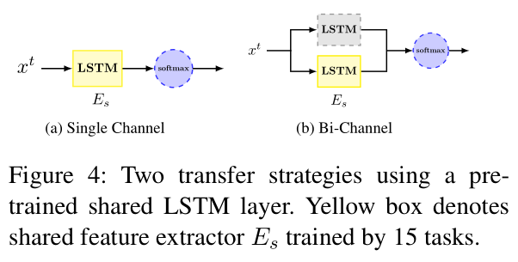
Knowledge transfer
1

Slide 18
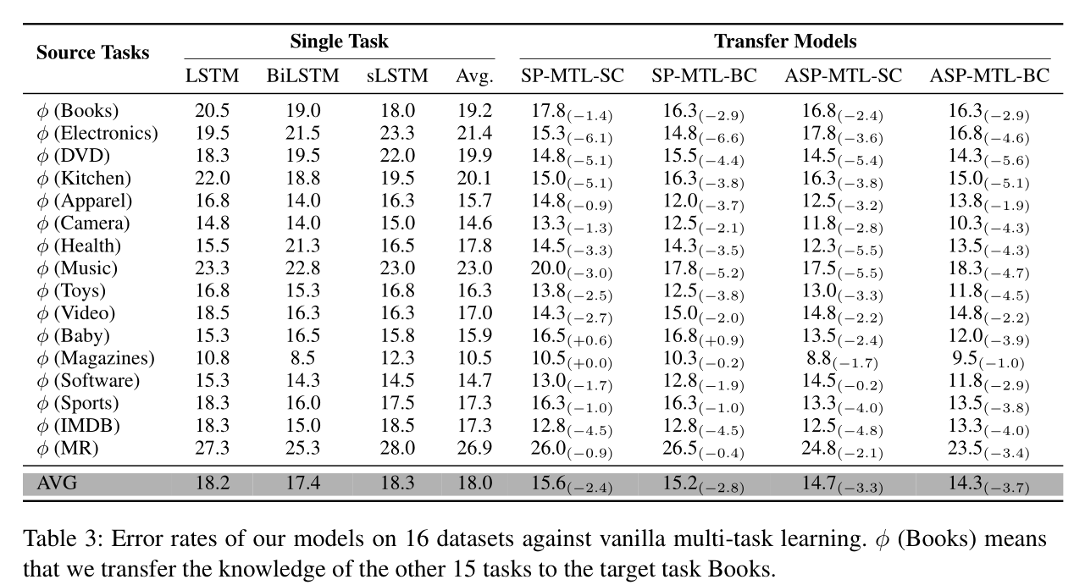
1

Slide 19
